Slide 1
CSE101-Lec#25
User defined data types(Structures)

Slide 2
Outline
Declaration of a structure
Definition and initialization of structures.
Accessing structures.

Slide 3
Introduction
Structures
Structure is a group of data items of different data types held together in a single unit.
Collections of related variables under one name
Can contain variables of different data types
Commonly used to define records to be stored in files.

Slide 4
Why Use Structures?
Quite often we deal with entities that are collection of dissimilar data types.
For example, suppose you want to store data about a car. You might want to store its name (a string), its price (a float) and number of seats in it (an int).
If data about say 3 such cars is to be stored, then we can follow two approaches:
Construct individual arrays, one for storing names, another for storing prices and still another for storing number of seats.
Use a structure variable.

Slide 5
Structure
There are three aspects of working with structures:
Defining a structure type
Declaring variables and constants of newly created type
Using and performing operations on the objects of structure type

Slide 6
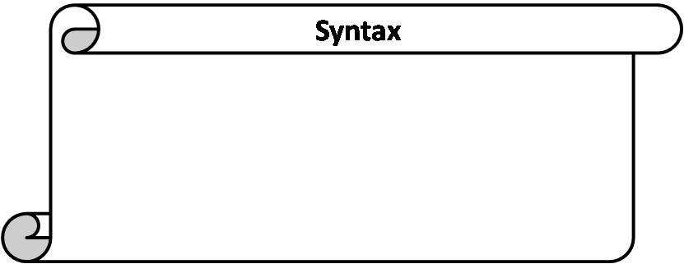
Structure Definition
struct sname {
type var1;
type var2;
type var3;
.
.
type varN;
};
struct is a keyword to define a structure.
sname is the name given to the structure/structure tag.
type is a built-in data type.
var1,var2,var3,…..,varN are elements of structure being defined.
; semicolon at the end.

Slide 7
Structure Definitions
Example:
struct car{
char *name;
int seats;
float price };
struct keyword introduces the definition for structure car
car is the structure name or tag and is used to declare variables of the structure type
car contains three members of type char, float, int
These members are name, price and seats.
No variable has been associated with this structure
No memory is set aside for this structure.

Slide 8
Structure Definitions
struct information
A structure definition does not reserve space in memory .
Instead creates a new data type used to define structure variables
Defining variables of structure type
Defined like other variables:
Car myCar, cars[5], *cPtr;
Can use a comma separated list along with structure definition:
struct car{
char *name;
int seats;
float price; } myCar, cars[5], *cPtr;
At this point, the memory is set aside for the structure variable myCar.

Slide 9
How the members are stored in memory
Consider the declarations to understand how the members of the structure variables are stored in memory
struct employee{
int id;
char name[20];
float salary; }e1;
Note: all members are stored in contiguous memory location in order in which they are declared.

Slide 10
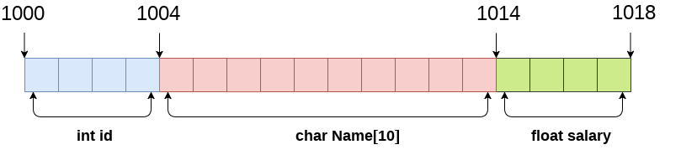
Memory allocation

Slide 11
Structure operations
Operations that can be performed on structures
Assigning a structure to a structure of the same type
Taking the address (&) of a structure
Accessing the members of a structure
Using the sizeof operator to determine the size of a structure

Slide 12
Initializing Structures
Initializer list
To initialize a structure similarly like arrays
Example:
struct car myCar = { “Renault", 500000, 2 };
Could also define and initialize myCar as follows:
struct Car myCar;
strcpy(name,”Renault”);//if name is array of characters
myCar.price = 500000;
myCar.seats = 2;

Slide 13
Accessing Members of Structures
Two operators are used to access members of Structures:
Dot operator (.) used with structure variables
struct car myCar;
printf("%d", myCar.seats);
Arrow operator (->) used with pointers to structure variables
struct car *myCarPtr = &myCar;
printf("%d", myCarPtr->seats);
myCarPtr->name is equivalent to
(*myCarPtr).seats

Slide 14
dot Operator
Members are accessed using dot operator.
It provides a powerful and clear way to refer to an individual element.
Syntax: sname.vname
sname is structure variable name.
vname is name of the element of the structure.
Eg: the members of the structure variable car can be accessed as
myCar.name, myCar.seats, myCar.price

Slide 15
Use of Assignment Statement for Structures
The main advantage of structure is that it can be treated as single entity.
The only legal operations that can be performed on structure are copying to it as a single unit using the assignment operator.
Value of one structure variable can be assigned to another variable of the same type using simple assignment statement.
If myCar and newCar are structure variable of type car, then
newCar = myCar;

Slide 16
Use of Assignment Statement for Structures
When we assigns value of structure variable myCar to newCar, all values of members of one structure get copied into corresponding members of another structure.
Or we can copy one member at a time:
newCar.name = myCar.name;
Simple assignment cannot be used this way for arrays.
This is really a big advantage over arrays where in order to copy one array into another of same type, we have copied the contents element by element either using loop or individually.

Slide 17
#include <stdio.h>
struct car{
char *name;
int seats;
float price;
}; //end structure car
int main()
{
struct car myCar; //define struct variable
myCar.name = “Renault”;
myCar.price = 500000;
myCar.seats = 2;
printf("%s\n%f\n%d \n”, myCar.name, myCar.price, myCar.seats);
} //end main
Program to show how to access structure.
Renault 500000 2

Slide 18
#include <stdio.h>
struct car{
char name[50];
int seats;
float price;
};
main()
{
struct car myCar;
printf(“Enter name of car:\n”);
gets(myCar.name);
printf(“Enter number of seats in car:\n”);
scanf(“%d”, &myCar.seats);
printf(“Enter price of car:\n”);
scanf(“%f”, &myCar.price);
printf(“\n\nParticulars of car are:\n”);
printf(“Car name:%s”,myCar.name);
printf(“\nNumber of seats:%d”, myCar.seats);
printf(“\nPrice:%f”, myCar.price);
} //end main
Program to enter data into structure.

Slide 19
Enter name of car: Micra
Enter number of seats in car: 4
Enter price of car: 600000
Particulars of car are:
Car name: Micra
Number of seats: 4
Price: 600000

Slide 20
Array & Structure
Array | Structure
1. It is a collection of data items of same data type. | 1. It is a collection of data items of different data types.
2. It has declaration only. | 2. It has declaration & definition.
3. There is no keyword. | 3. struct is the keyword.
4. An array name represents the address of the starting element. | 4. A structure name is called tag. It is a short hand notation of the declaration.

Slide 21
Q1
What will be the output of following code?
#include<stdio.h>
struct employee
{
char name[20];
int rollno;
float salary;
};
int main()
{
struct employee e1={"Smith"};
printf("%f",e1.salary);
return 0;
}
Compile time error
0.000000
1
Garbage value
Notes:
B

Slide 22
Q2
What will be the output of following code?
#include<stdio.h>
struct book
{
char b_name[50];
int no_of_pages;
float price;
};
int main()
{
struct book b1={"Programming"};
printf("%d",b1.no_of_pages);
return 0;
}
1
0
Compile time error
Garbage value
Notes:
B

Slide 23
Q3
What will be the output of following code?
#include<stdio.h>
struct student
{
char name[20];
int roll_no;
float fees
}v1={"Goerge",23,4500.45},v2={"Tom",45,3400.56};
int main()
{
printf("%d",v2.roll_no);
return 0;
}
45
23
Garbage value
Compile time error
Notes:
A

Slide 24
Q4
What will be the output of following code?
#include<stdio.h>
struct student
{
char name[20];
int roll_no;
float fees
}v1={"Goerge",4500.45};
int main()
{
printf("%d",v1.roll_no);
return 0;
}
Garbage value
4500
4500.45
0
Notes:
B

Slide 25
Q5
What will be the output of following code?
#include<stdio.h>
struct student
{
int a=10;
}v1;
int main()
{
printf("%d",v1.a);
return 0;
}
10
0
Compile time error
Garbage value
Notes:
C

